Slide 1
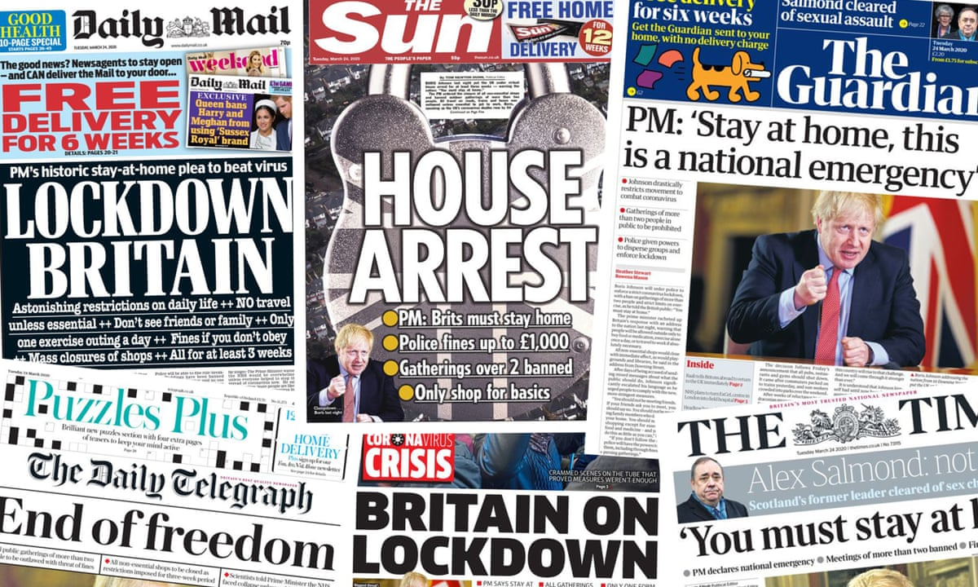
Resource model Communication Discussion group
Mark Lukacs
10/14/2022
Notes:
Introduce participants (Mart)
Start recording
Welcome
I hope everybody filled or going to fill the consent form, but if you have an objection to be recorded, say it now
Imagine a situation where
Respiratory disease
Outbreak
Couple of reports about resources not enough
Patients getting transferred between hospitals
There are issues on the deeper level too
No past experience, and no guidelines about how to solve the situation
Debate in the general public
And an intense interest + criticism from regular people

Slide 2








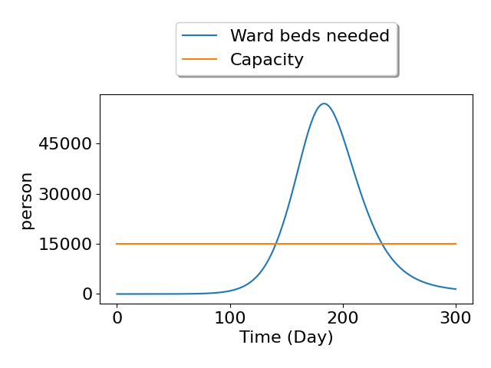
Introduction
Imagine a situation
Predictions →
Support decisions-makers
How?
Introduction
Notes:
There is a professional consensus that the situation is about to worsen
You’re in the position to make decisions
My question is: How to support you making your decisions?

Slide 3
Agenda for today
Introduction 13:00 – 13:05
Project background 13:05 – 13:10
Workshop 13:10 – 13:55 (max 14:25)
Future work 13:55 – 14:00
Introduction
Notes:
Introduction – just had
Project background
Evaluation of model outputs
Brief mention of future work

Slide 4
Agenda for today
Introduction 14:00 – 14:05
Project background 14:05 – 14:10
Workshop 14:10 – 15:55 (max 15:25)
Future work 14:55 – 15:00
Introduction
Notes:
Introduction – just had
Project background
Evaluation of model outputs
Brief mention of future work

Slide 5
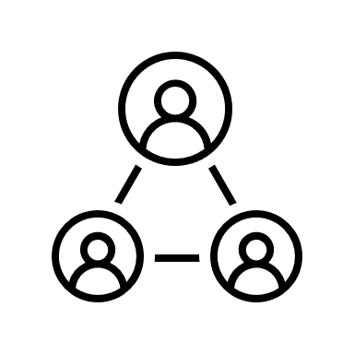







Project background
Public health – Hospital resource
Master Thesis
How to evaluate models
PANDEM-2
Preparedness
Dashboard
Focusing on resources
me hopefully :))
Project Background
Notes:
Context surrounding this project
Theoretical side
Managing a pandemic needs - Public health resources – hospital resources
There is potential for better coordination
Operational side
My master Thesis at TU Delft about How can healthcare resource models be evaluated for different pandemic scenarios under uncertainty?
Research group context
PANDEM-2
EU Horizon-2020 project
Preparedness - In many ways
One is gaining insight through model
Dashboard to communicate the model outputs to wider audience
Communicating everything from the model is very inefficient
Goal of this workshop – determine how to communicate effectively
Pre-analyse model outputs
Determine which way to analyze / How much to analyze
Given all this context: my thesis’s focus is on the resources - not on the epidemiology part

Slide 6
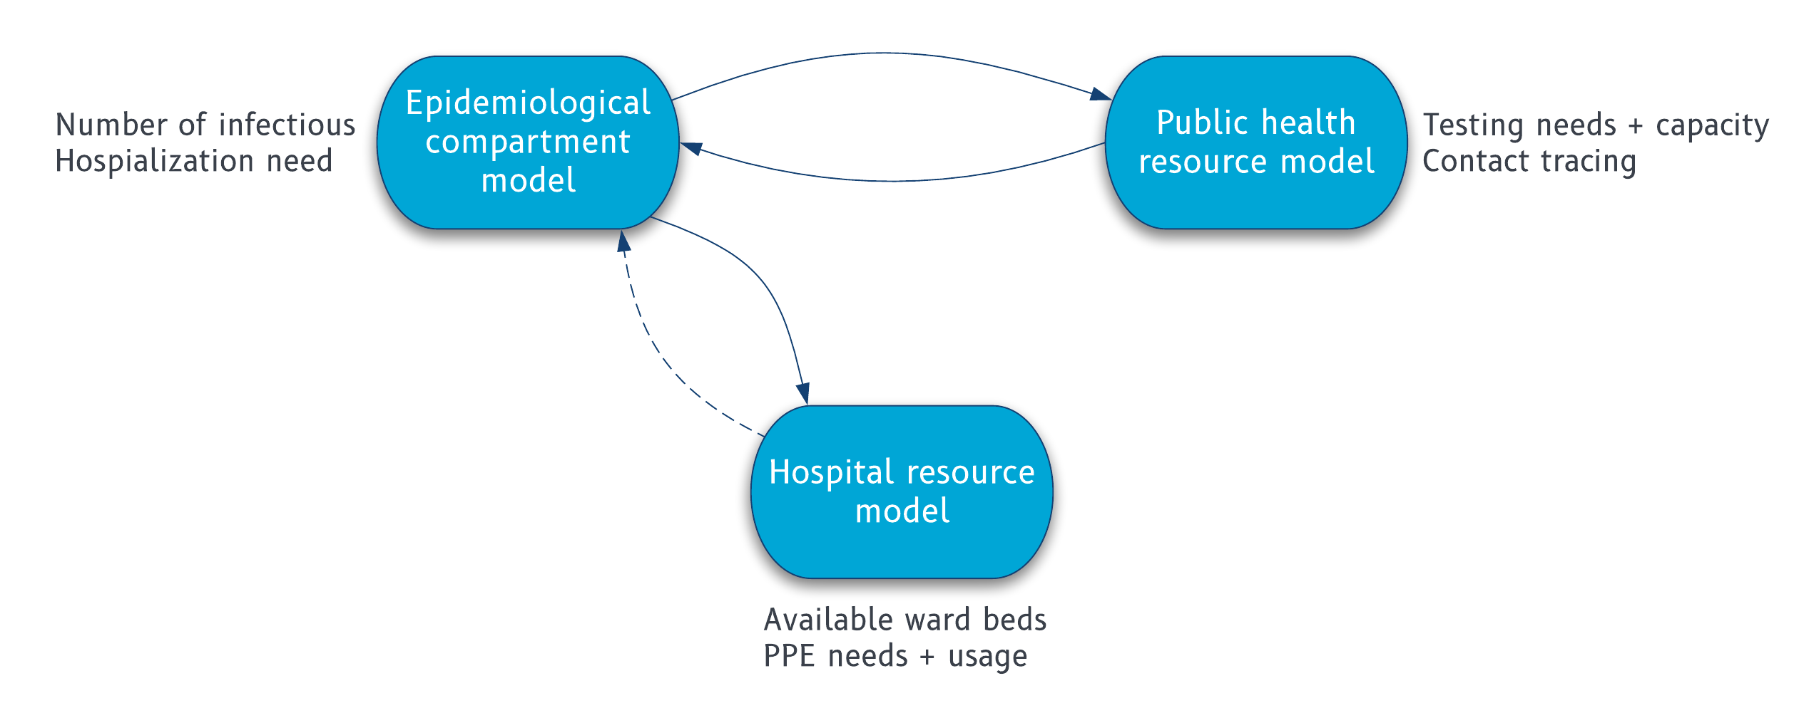
Project background
Model structure
Project Background
Notes:
The model consists of 3 main sub-models
Compartment model (how people get sick)
Public health resources
Hospital resources
Feedback effects:
Lack of public health resources (such as tests) feedback to the compartment model, making the pandemic worse
Same but way weaker effect between the hospital resources and the compartment model
No direct influence between the public health and hospital resource sub-models
Treat the model as a best ‘working theory’ (we know it’s not fully aligned with reality, but for our goals it is sufficiently accurate)

Slide 7

Workshop
Notes:
Should I provide clarification on anything so far?
Image: Pandem-2.eu

Slide 8
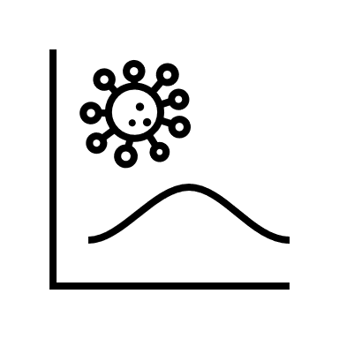
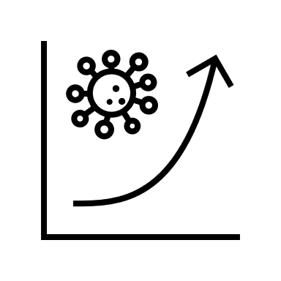






How this workshop works
4 interventions
How easy it is to understand this type of output? (1-9)
What does this communicate to you?
Workshop 0/4
What does it prompt you to do?
Notes:
What will happen
I will present 4 interventions that have the possibility to alter which scenario the pandemic ends in
You will see quite some data, mostly as graphs
Then we will explore how much the intended supporting data supports your thinking
We will use 3 guiding question for this
How easy it is to understand this type of output? (rating)
What does this communicate to you? (discussion)
What does it prompt you to do? (discussion)
There’s a pitfall easy to fall into: Try not to discuss the quality of the data, but the quality of the presentation of the data. Example:
Try not to discuss if the epidemic wave is realistic, but try to discuss whether the graphs are communicating the epidemic’s progression clearly enough

Slide 9
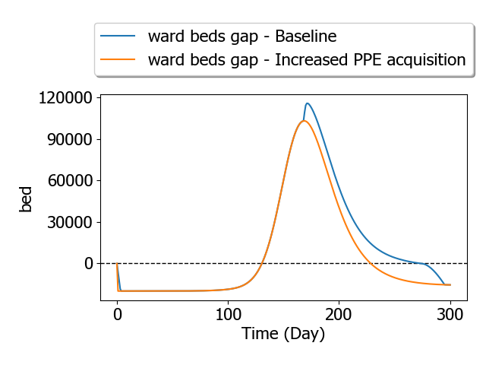
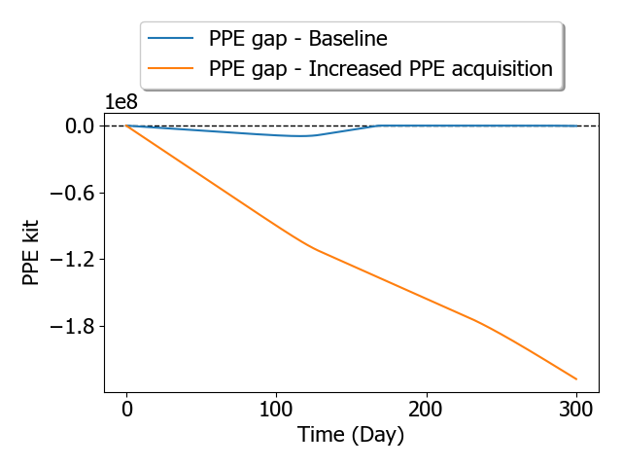
Increase in PPE acquisition
No change in
Epi parameters (model limitation)
Public health resources
Workshop 1/4
Notes:
Bit of terminology
- intervention – possibility to change the course of the pandemic
- parameters – the inputs which determine the ‘starting state’ of the pandemic model. A single parameter is one of these inputs
First intervention
Opportunity to increase PPE acquisition – in the model there is a PPE stockpile for hospitals, and the newly bought PPE first goes there. Increasing the acquisition means more is going to the stockpile each day
Left graph: the gap in ward beds – required beds – available beds
positive: gap – negative: surplus
blue – baseline, orange – intervention
Left – ward beds, right – PPE
All the changes are visible on the graphs
no change in how the epidemic progresses (this is a know limitation of the model)
Left blue bump: PPE shortage was limiting how many ward beds can be provided by hospitals
The ICU has priority for getting PPE, so it's not effected by this PPE gap

Slide 10
Increase in PPE acquisition
No change in
Epi parameters (model limitation)
Public health resources
Workshop 1/4
Notes:
Questions
How easy it is to understand this type of output?
Rating is from 1 to 9!
Imagine that you’re making the decision
What does this communicate to you? (discussion + Word cloud)
What does it prompt you to do? (discussion)

Slide 11
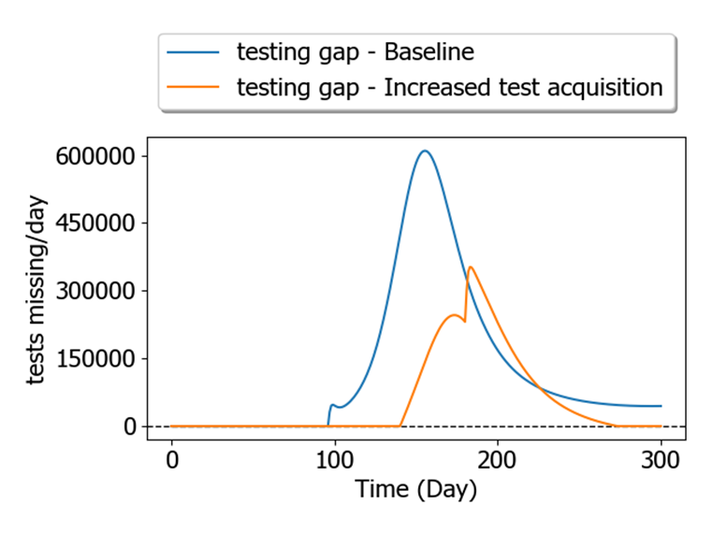
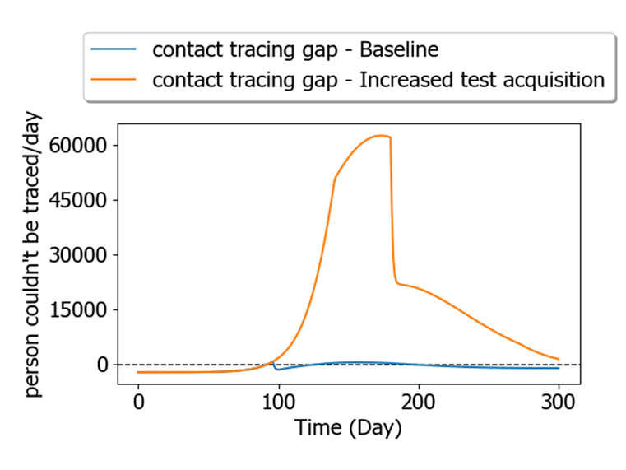
Increase in test acquisition
Less severe epidemic
More impact on contact tracing
Workshop 2/5
Notes:
Second intervention: increase test acquisition
Similarly to before, newly acquired tests go into a stockpile first
Like before, blue lines represent the base case, and orange ones the intervention
Effects:
On the left we see the testing gap, and it's visibly smaller in the case of increased test acquisition
On the right side we see that there's a big impact on how many person can’t be contact traced
This seems like a trade-off until we look into the bigger picture

Slide 12
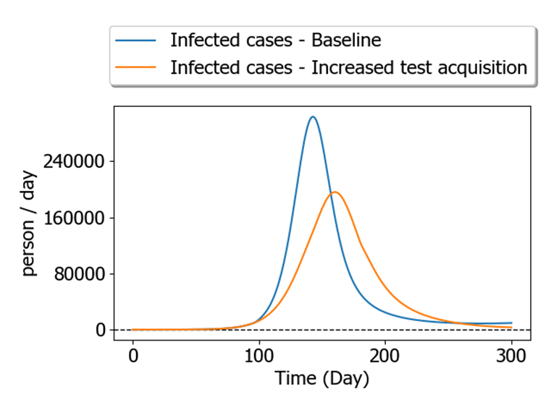
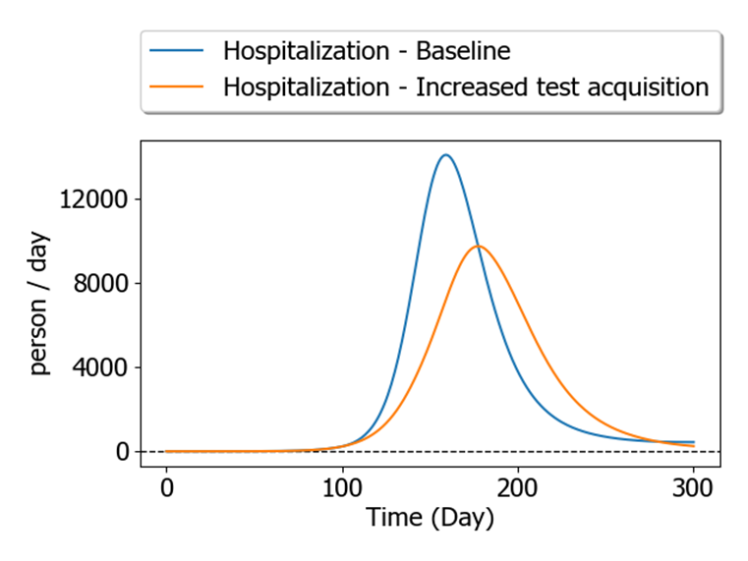
Increase in test acquisition
‘Catch-early’ effect
Workshop 2/4
Notes:
In this two graphs we see the number of infected, and the number of hospitalized people.
From these graphs it is absolutely clear that despite the creation of the contact tracing gap, having more tests helps to flatten the wave
More people get tested > more people isolating > smaller force of infection > smaller epidemic

Slide 13
Increase in test acquisition
Less severe epidemic
More impact on contact tracing
Workshop 2/4
Notes:
Questions
How easy it is to understand this type of output? (Likert scale)
Imagine that you’re making the decision
What does this communicate to you? (discussion + Word cloud)
What does it prompt you to do? (discussion)

Slide 14
Reduced ‘ward length of stay’
Parameter | Baseline | Decreased LoS
Ward bed capacity gap | Max: 115 000 Day 120 - 280 | Max: 60 000 Day 125-230
Period of PPE gap | 130 days | 85 days
Deceased (total) | 110 000 | 75 000
Other parameters | same
Workshop 3/4
Notes:
Now let’s try a different method of presenting the data:
Intervention: reducing how early patients released from the ward.
Deceased - model limitation
[explain the table]

Slide 15
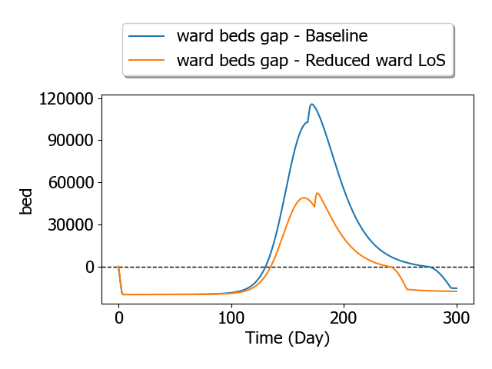
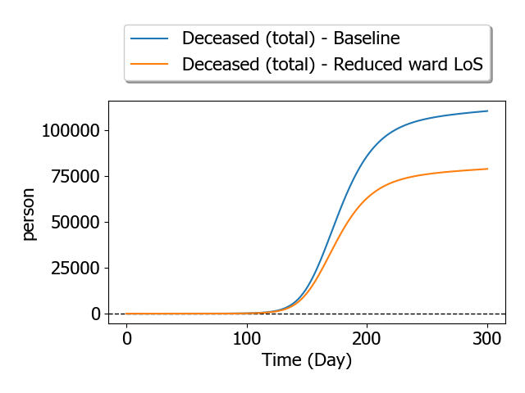
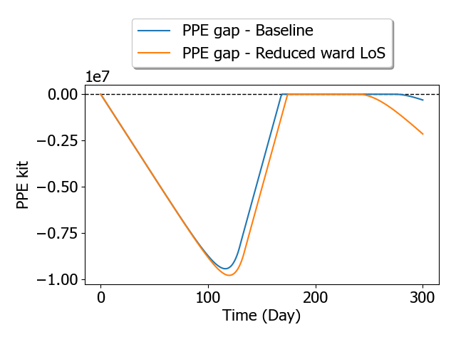
Reduced ward length of stay
Workshop 3/4
Notes:
guesstimated these diagrams

Slide 16
Reduced ‘ward length of stay’
Parameter | Baseline | Decreased LoS
Ward bed capacity gap | Max: 115 000 Day 120 - 280 | Max: 60 000 Day 125-230
Period of PPE gap | 130 days | 85 days
Deceased (total) | 110 000 | 75 000
Other parameters | same
Workshop 3/4
Notes:
Questions
How easy it is to understand this type of output? (Likert scale)
Imagine that you’re making the decision
What does this communicate to you? (discussion + Word cloud)
What does it prompt you to do? (discussion)

Slide 17
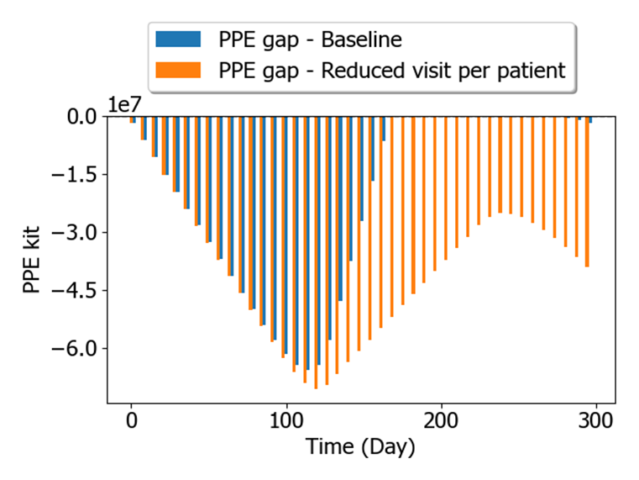
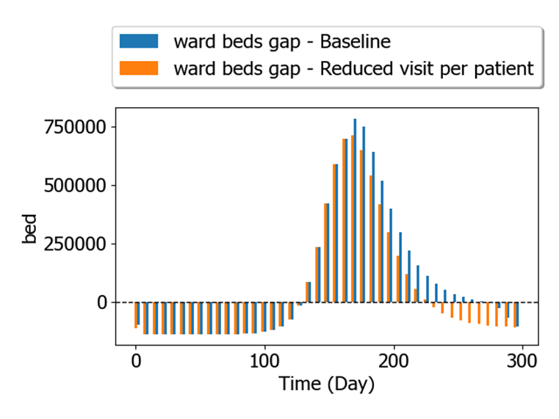
Reduced ‘visit per patient’
Less PPE used
Similar to first intervention
No change in ‘ICU beds gap’
Workshop 4/4
Notes:
4th intervention – Reducing the number of times patients are visited – both for ICU and for ward
On it’s own it’s reducing the usage of PPE -> very similar to the first intervention
No change in ICU beds gap because of other constraints

Slide 18
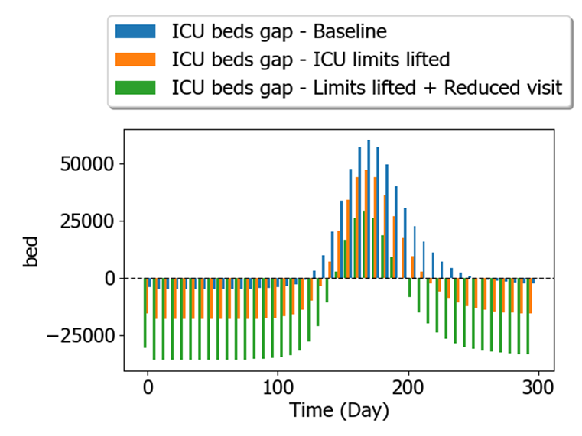
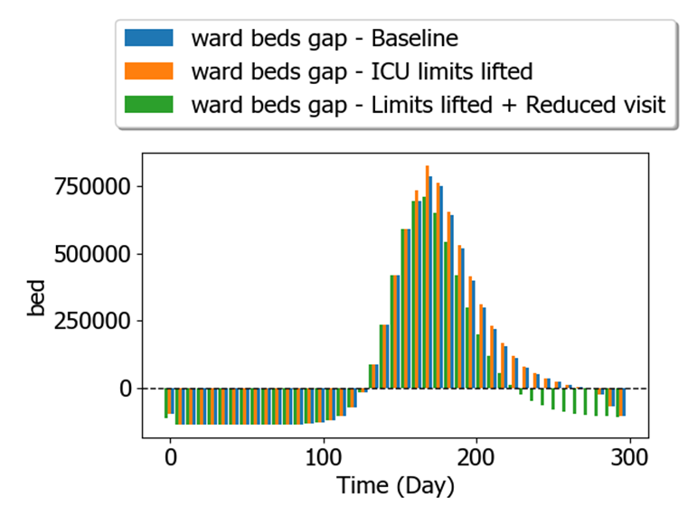
Reduced ‘visit per patient’
Other limits lifted
Slight change in ward gap
Workshop 4/4
Notes:
So let’s lift these other limits
Blue – still the baseline – Orange – effect of listing these limits – Green – lifting the limits AND reducing the visits per patient
Effects of lifting the limits:
More ICU beds available through the epidemic, since the only limiting factor now is the staff
On the right side: minimally bigger gap in the ward bed, since increased capacity ICU uses more PPE – ward’s PPE shortage happens sooner
Effects of lifting the limits and reducing visits
Drastically increased ICU capacity – Less visits per patient means the same staff can treat more people (still no limits from other factors since I switched those off)
Smaller gap in ward: due to reduced visit less PPE used during treatment -> there is no PPE shortage

Slide 19
Reduced ‘visit per patient’
Other limits lifted
Slight change in ward gap
Workshop 4/4
Notes:
Questions
How easy it is to understand this type of output? (Likert scale)
Imagine that you’re making the decision
What does this communicate to you? (discussion + Word cloud)
What does it prompt you to do? (discussion)

Slide 20

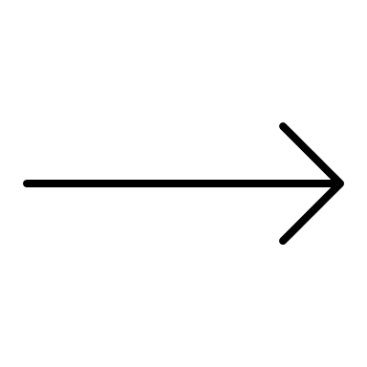


Future work
Analyze your answers
Recommendations for PANDEM-2
Future work
Notes:
Thanks for your inputs
I will go back behind my desk to analyze the answers and to draw conclusions from it
I will provide some recommendations for the PANDEM-2 project, especially about what’s important for the dashboard.
I will send a copy to you once that’s done

Slide 21

Some backup slides
Notes:
Image: Pandem-2 presentation template

Slide 22
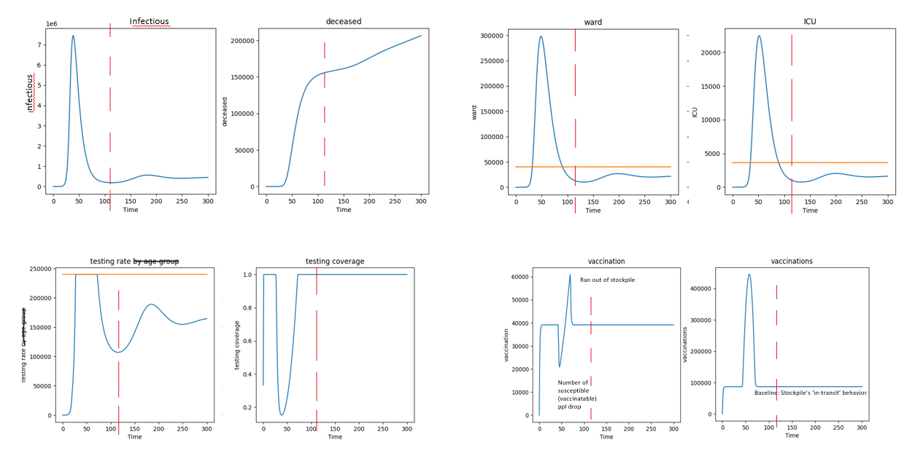


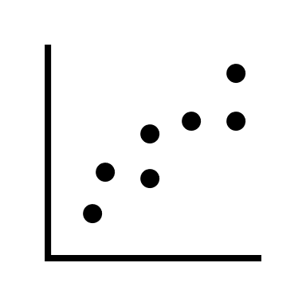

Project background
Communicate model results
Bad example
Pre-analyse outputs
Which way?
Inefficient
Project Background
or

Slide 23
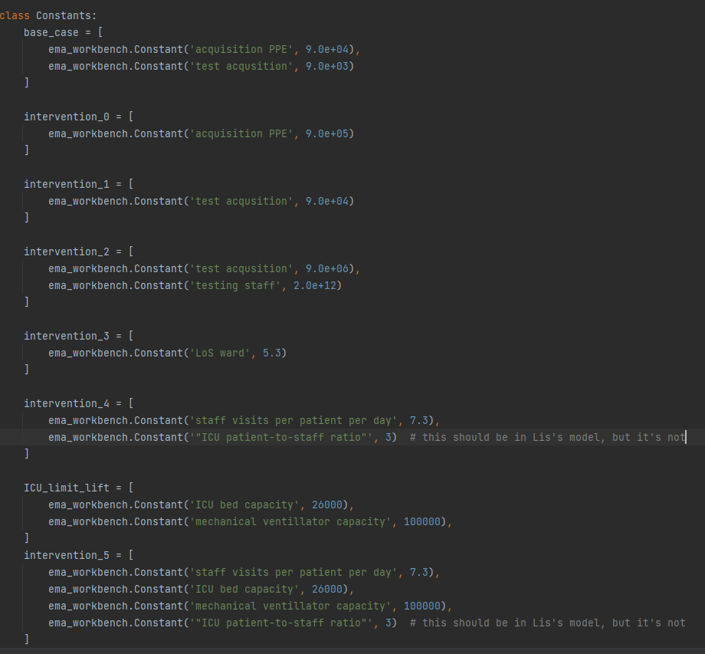
Interventions in detail
Workshop 0/4

Slide 24
Old todo lists + ideas
Notes:
Image: Pandem-2 presentation template

Slide 25
TODO (old)
Debug the SD model (chance of death) wontfix
Graphing
1e7 -> 10M

Slide 26
TODO
Process feedback from last meeting
Send MS question handling to Berend
Plotting exclude day 0
PrioB
Fix formatting
Check for usage of I language (instead of we)
Re-color icons to gov-blue or matplotlib-blue
1e7 -> 10M (PPE stockpile)
Future work

Slide 27
Questions from last time..
Discuss when is it a limitation of the model, or not? - just mention that’s a limitation, but don’t apologize about it :p
Privacy en HREC
Remove recording after using (say it in ppt) – Berend has a line (standard RIVM procedure) --- keep everything on RIVM servers
(quotes: Berend will ask the privacy coordinator about it) (prob need to inform participants, short text beforehand)
Just call them participants A-F(?) ++ generic text reporting on the ‘mix of expertise’, but ‘highest level of anonymity’
Evaluation 1/5

Slide 28
Intervention 5 – advanced
Intervention
Reduced ICU visit per patient + reduced PPE acquisition
Removed for simplicity’s sake
patient to staff ratio + increased ICU bed capacity + number of ventilators
Epi-parameters: No change
Public health parameters: No change
Reduced visit and ratio effect the ICU capacity
Workshop 5/5
Notes:
Code to recreate: Uncertainties. fake_ICU_patient_to_staff_ratio_advanced
[fake]

Slide 29
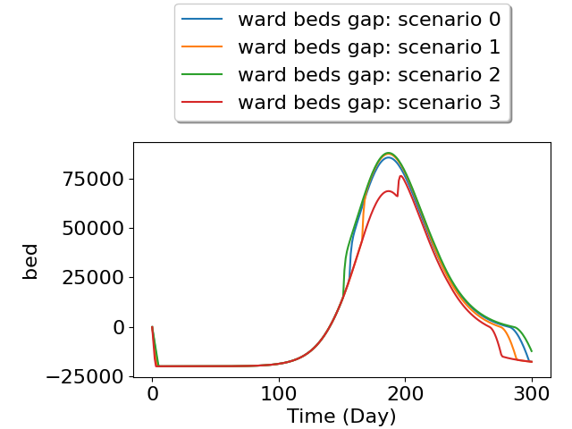
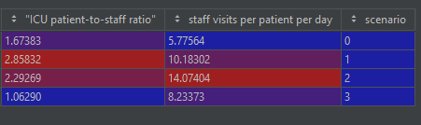
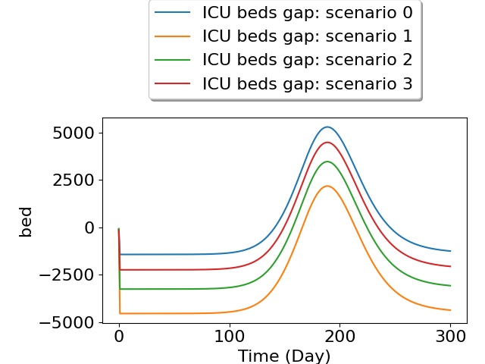
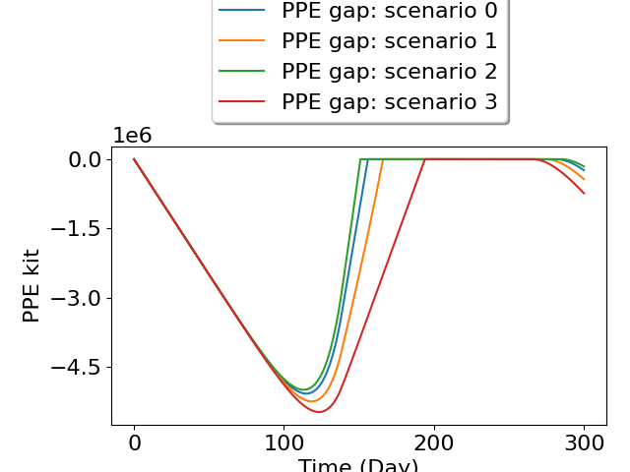
Intervention 5 – advanced
Reduced ICU visit per patient + increased ICU bed capacity + number of ventilators + reduced PPE acquisition
Workshop 5/5
Notes:
Code to recreate: Uncertainties. fake_ICU_patient_to_staff_ratio_advanced
[fake]

Slide 30
Intervention 5 – advanced – Discussion
Workshop 5/5
Notes:
Differently presented scenarios
Same questions
How easy it is to understand this type of output? (Likert scale)
What does this communicate to you? (discussion + Word cloud)
What does it prompt you to do? (discussion)

